Slide 1

Project - Oil Prices Prediction (P179)
Guided by – Karthik Sir
Group 2
Anjali
Sukanya
Mamta
Nikita
Amey

Slide 2
Objective
Oil is a product that goes completely in a different direction for a single market event as the oil prices are rarely based on real-time data, instead, it is driven by externalities making our attempt to forecast it even more challenging.
As the economy will be highly affected by oil prices our model will help to understand the pattern in prices to help the customers and businesses to make smart decisions.
Business Problem
To build a forecasting model to predict the future oil prices to that aid management to reduce operational costs, increase profit and enhance competitive advantage.
Data Insights
The data extracted are the Crude oil prices of Brent–Europe measured in Dollars per Barrel dated from 1987 till 2022.

Slide 3

Project Flow

Slide 4
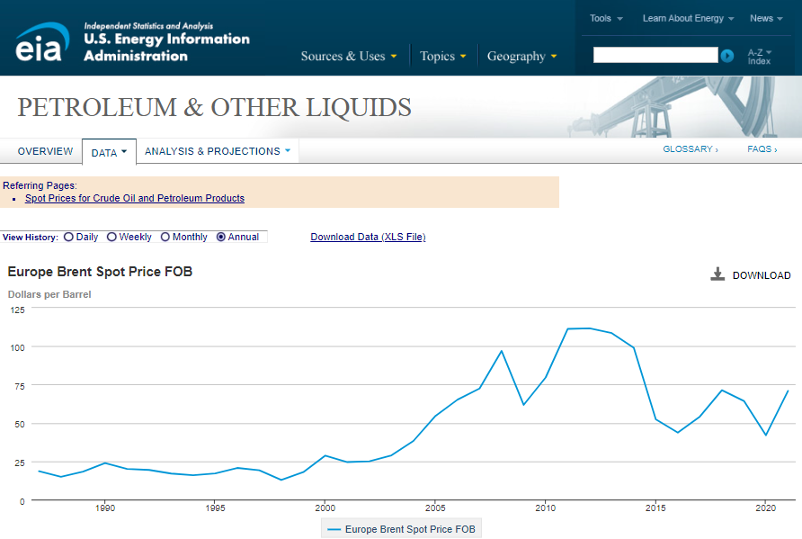
Data Extraction
The Data was extracted from :- https://www.eia.gov/dnav/pet/hist/LeafHandler.ashx?n=PET&s=RBRTE&f=A

Slide 5
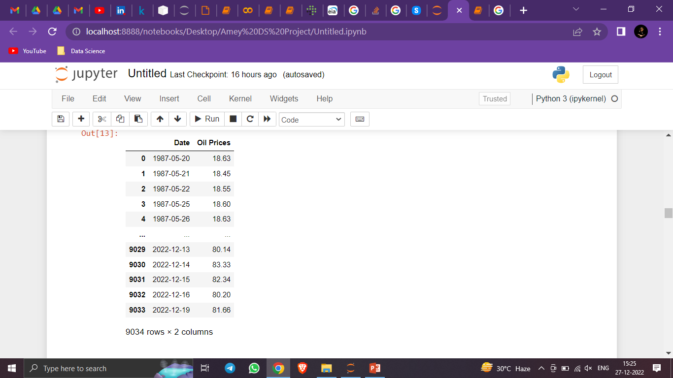
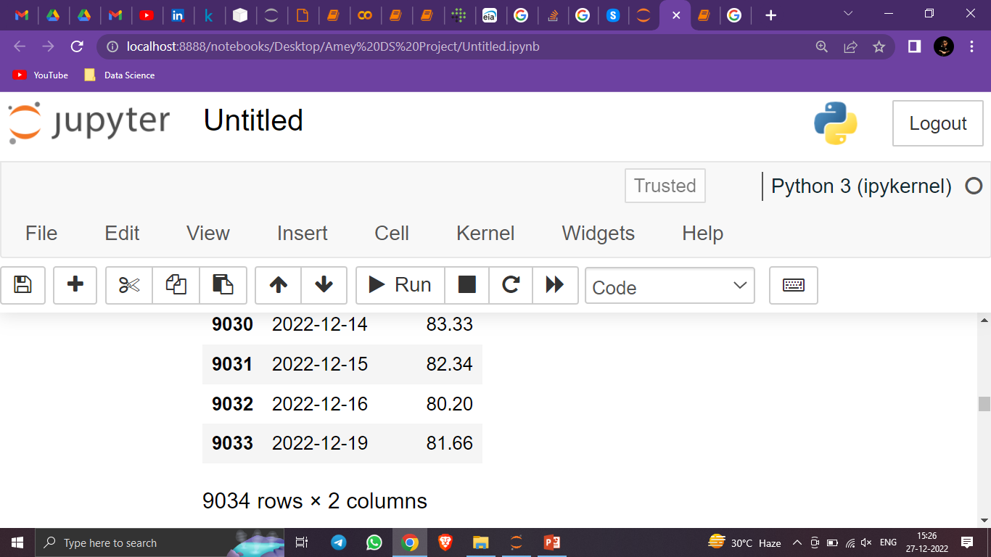
In the left side image in this same slide, we have noticed that, the Dataset doesn’t contain the values for Saturday and Sunday.
For example, if you look closely at 17th and 18th December (Saturday & Sunday), we can see that they are missing, and this all because the Oil Market is closed on weekends.

Slide 6
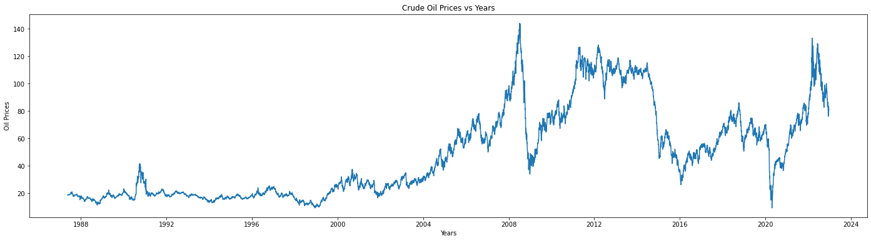
Exploratory Data Analysis (EDA)
From the above Line Graph, we can say that the Crude Oil Prices has tend to show an UPWARD trend from 1987 till 2007.
In the Year 2008, the Great Recession occurred and then Oil Prices dropped suddenly.
After the Great Recession, Oil Prices started to rise till the year 2011.
Then from year 2011, Oil Prices were dropping dramatically towards 2015.
From year 2015 onwards, the Oil Prices seem to fluctuate with some peaks and falls till the 2020 Pandemic Year.
From year 2021 till present it is showing a Growing Trend.

Slide 7
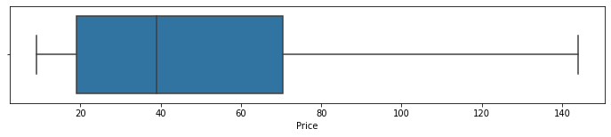
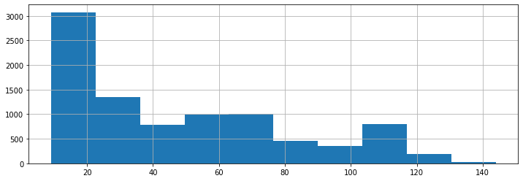
Outlier Detection
As we can see in above image, there are no outliers present.
Histogram
Most of the data varies from 0 to 40. Data is Rightly-Skewed.

Slide 8
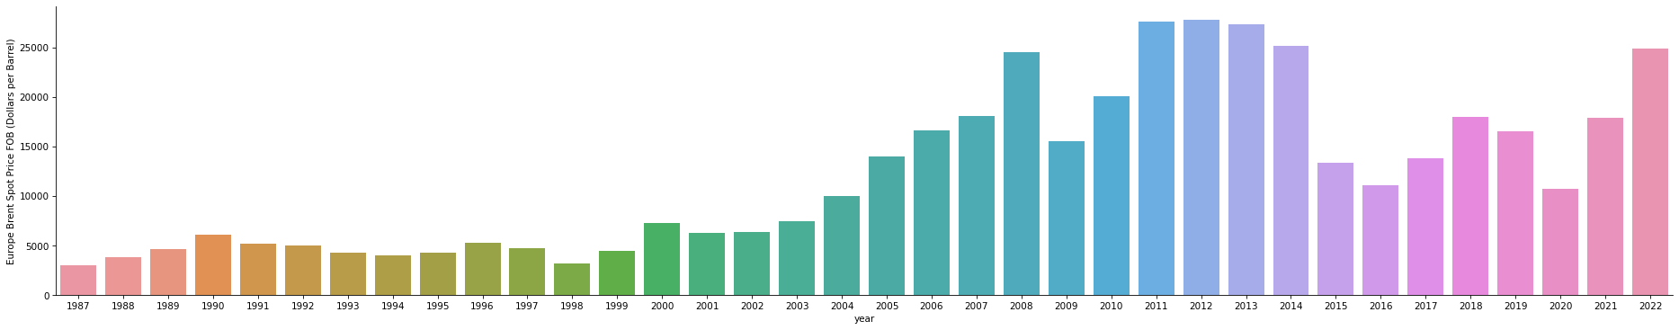
Sum of all sales each year.
Above graph shows sum of all sales from 1987 to 2022.

Slide 9
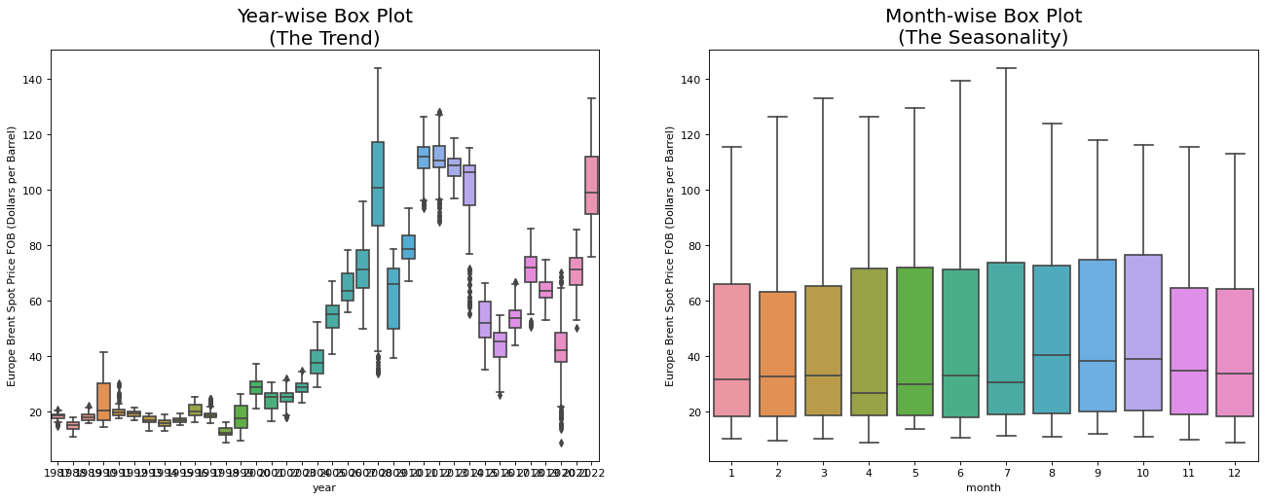
Monthly & Yearly Oil Price (Trend & Seasonality)
Above Boxplot shows Year-wise Trend & Month-wise Seasonality.

Slide 10
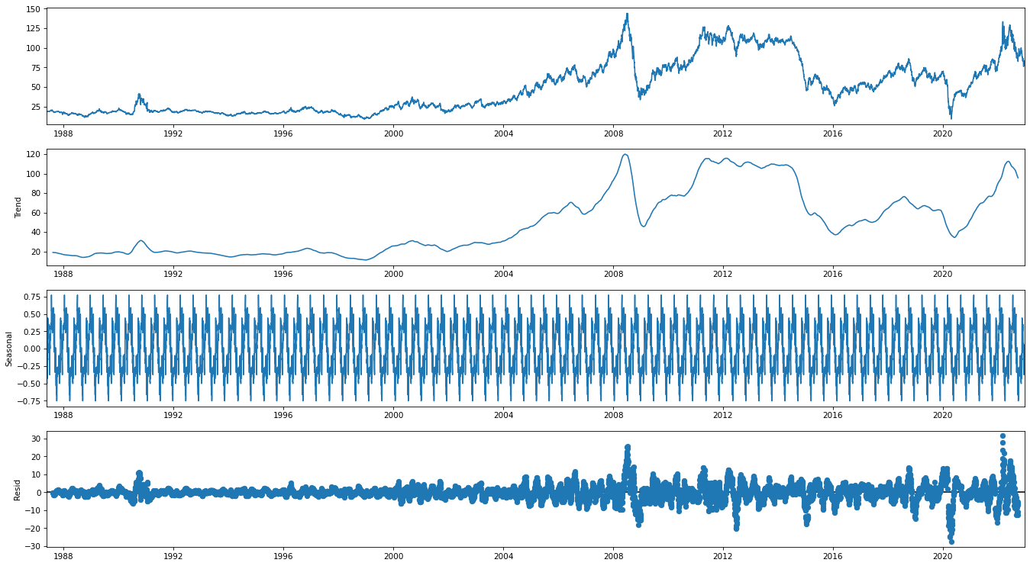
Time Series Decomposition
Additive Seasonal Decomposition
Explanation is given at next slide.

Slide 11
Time Series Decomposition Explanation
Additive Seasonal Decomposition
Trend :- Slow moving changes in a time series, Responsible for making series gradually increase or decrease over time.
Seasonality :- Varies from +0.5 to -0.5 with the mean 0. Each cycle represents each year trend. The value in the Y-axis has to be added to the Trend plot value to get the actual value of that year.
E.g.:- For the year 1988 Nov, the seasonal value is +0.5 and the trend value is 100.
Hence, the actual value(passengers number) will (Seasonal + Trend) value = 0.5+100 = 100.5
Residuals :- It is the noise pattern of the time series data for each year, which was not captured by the two components - Trend and Seasonality. Residual is the left over after decomposition of the two major components (Trend and Seasonality).

Slide 12
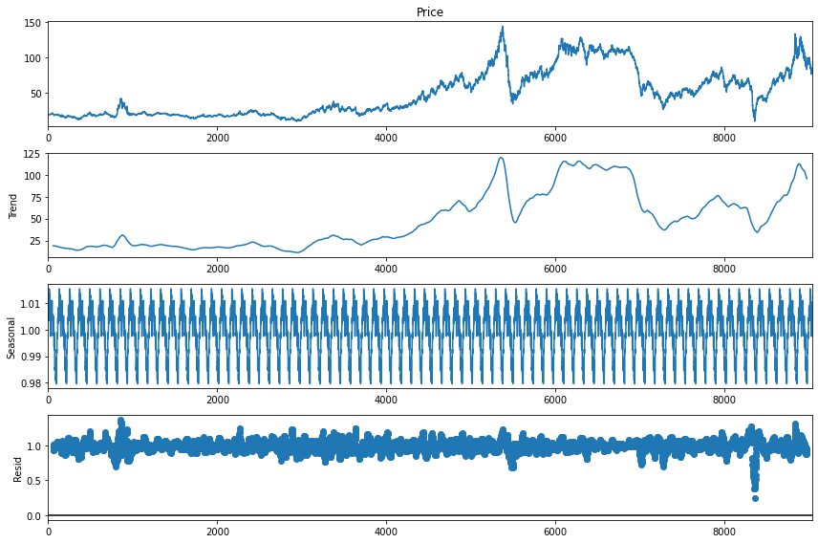
Time Series Decomposition
Multiplicative Seasonal Decomposition
Explanation is given at next slide.

Slide 13
Time Series Decomposition Explanation
Additive Seasonal Decomposition
Trend :- Slow moving changes in a time series, Responsible for making series gradually increase or decrease over time.
Seasonality :- Varies from 0.98 to 1.01 The value in the Y-axis has to be multiplied to the Trend plot value to get the actual value of that year.
E.g.:- For the year 1988 Nov, the seasonal value is 1.01 and the trend value is 100.
Hence, the actual value(price) will (seasonal X Trend) value = 1.01 X 100 = 101

Slide 14
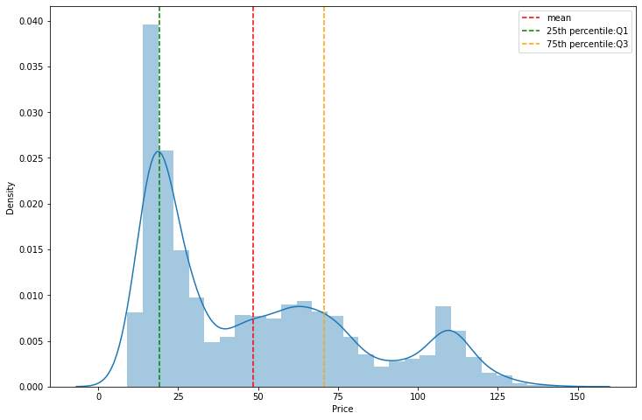
Distribution Plot
To check the Normality of Data.
We can see from this Displot Data is not Normally Distributed.

Slide 15
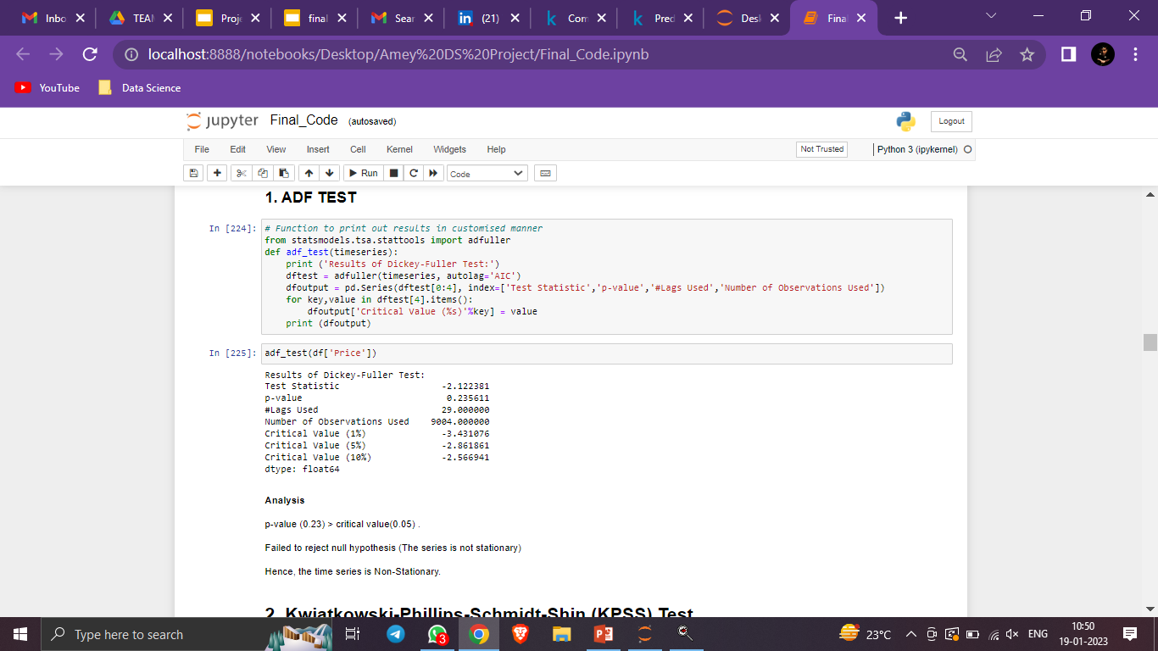
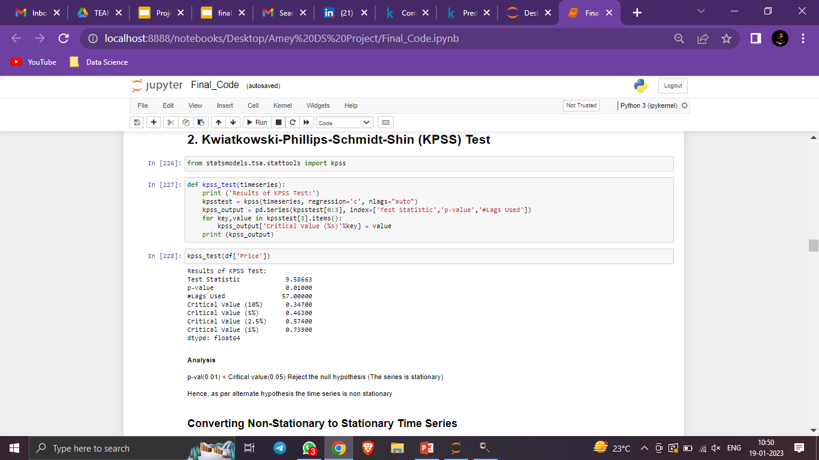
Test for Stationarity of Data
1. Augmented Dickey Fuller Test
The p-value obtained is greater than significance level of 0.05 and the ADF test statistic is higher than any of the critical values.
Clearly, there is no reason to reject the null hypothesis.
So, the time series is in fact non-stationary.
2. Kwiatkowski-Phillips-Schmidt-Shin (KPSS) Test
Here Test Statistic > Critical Value and p-value <0.01.
As a result, we reject the Null hypothesis in favor of an Alternative.
Hence we conclude series is non-stationary.
Therefore we can confirm from both the tests, that our data series is not stationary and will require some transformations as pre-processing part before building our prediction models.

Slide 16
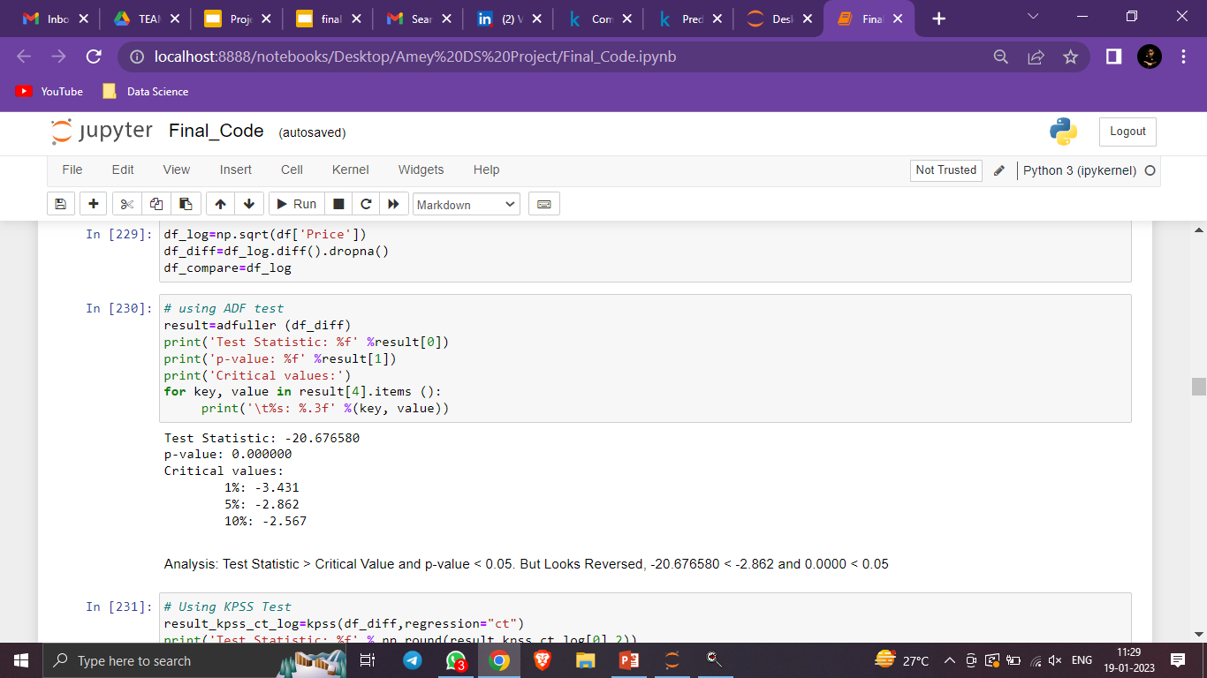
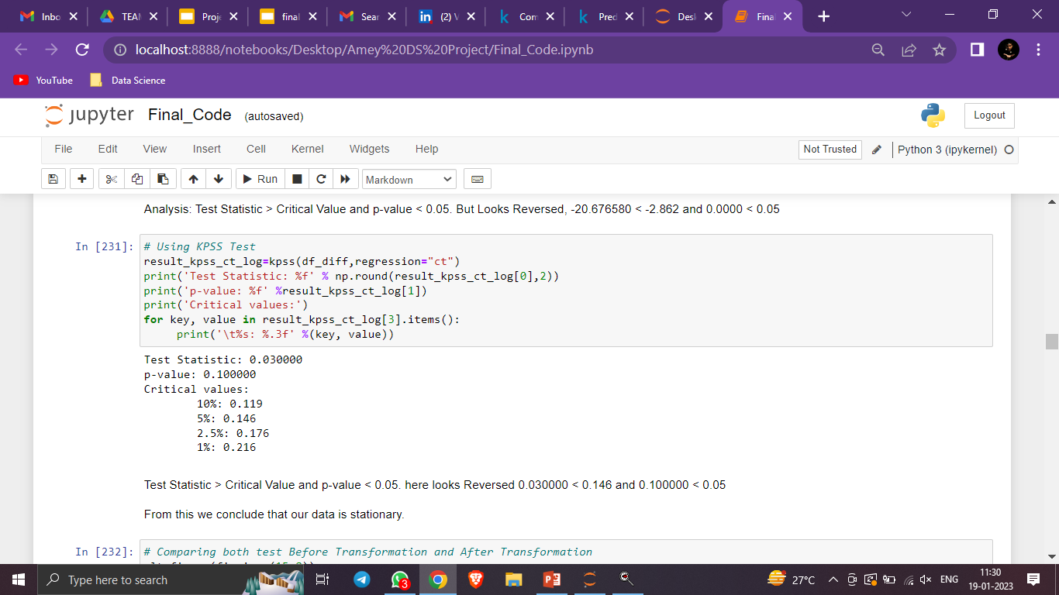
Data Pre-Processing
Removing the trend and seasonality to make the series stationary for further modelling.
To remove the trend we used the following transformation and results are as follows :-
Log Transformation
From this we conclude that our data is stationary.

Slide 17
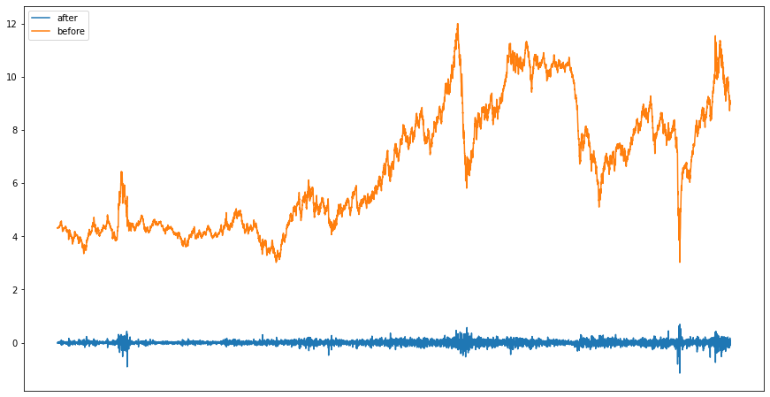
Comparing both test Before Transformation and After Transformation

Slide 18
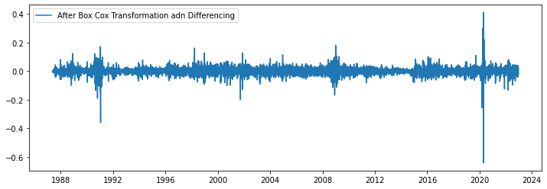
Differencing
Analysis
We can see that there is no trend (upward or downward) after differencing on the Box Cox transformation.
It is a horizontal trend.
The mean became constant.
The mean is zero.
Also, the variance is almost constant.
Lets test the Stationarity again.

Slide 19
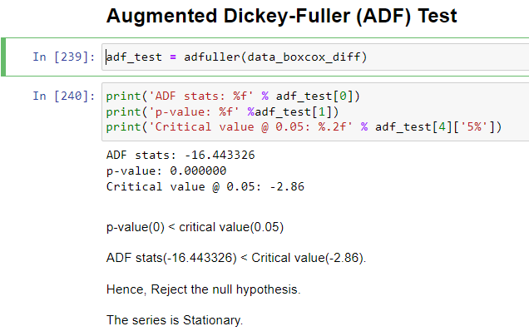
We did the ADF Test again.
Hence, the series is found to be Stationary.

Slide 20
Conclusion on Data Pre-Processing
If you look closely we have obtained same results for differencing as those of on log transformation.
The p-value is smaller than the significance level of 0.005 as well as the test statistics at critical value (1%) seems the closest indicating that we are 99% confident that our data is stationary.
As a result, we decided to choose transformation results for our modelling even thought it only deals with the trend, we will use the models which deal with the seasonality like the Holt-Winters Exponential Smoothening, Prophet Model by FB as our forecasting models.

Slide 21
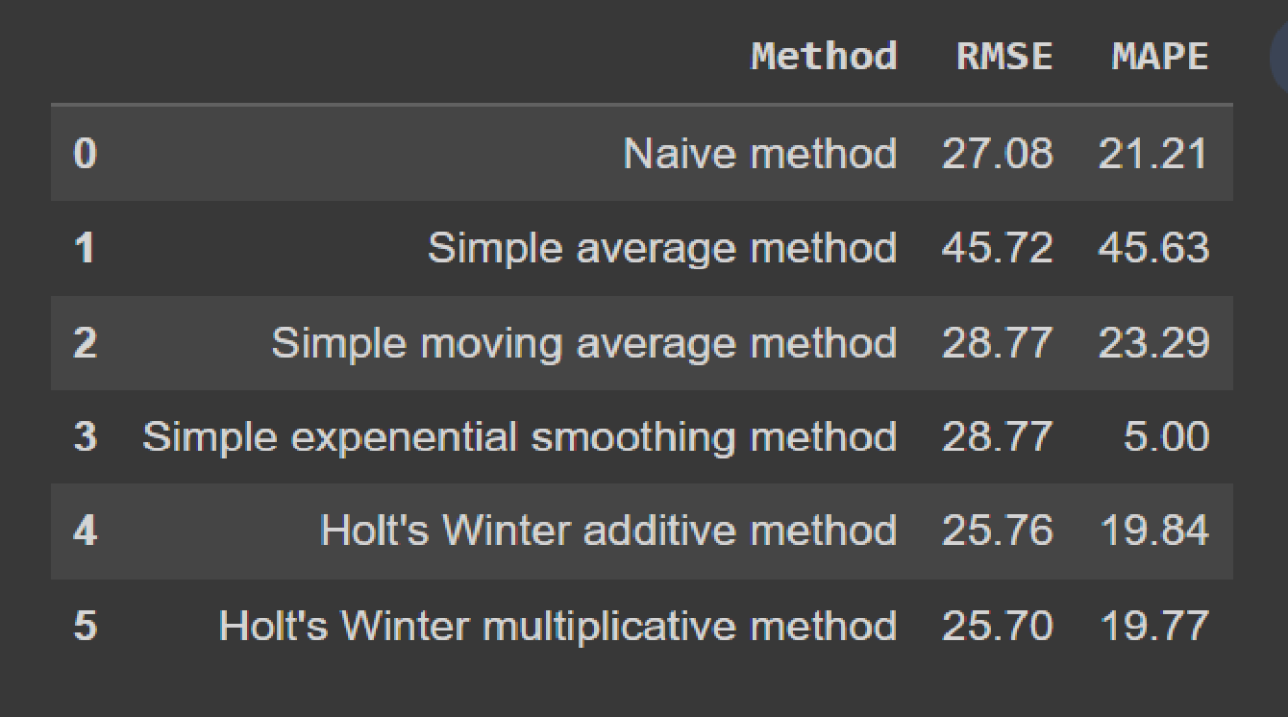
Model Building
Building various models to forecast the crude oil prices
Model using the pmdarima’s train_test_split cross-validation
Training size is : (8582, 6)
Testing size is : (452, 6)

Slide 22
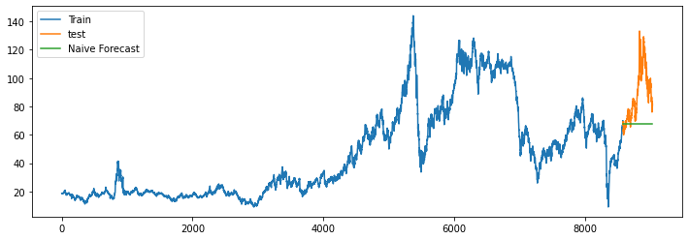
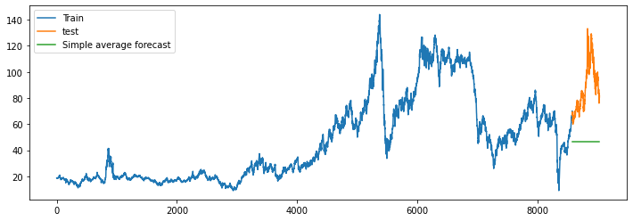
A) Naive Method
B. Simple average method

Slide 23
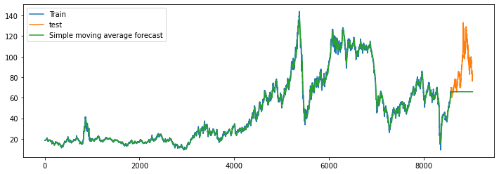
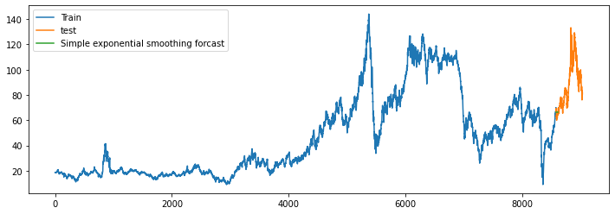
C. Simple moving average method
D. Simple exponential average method

Slide 24
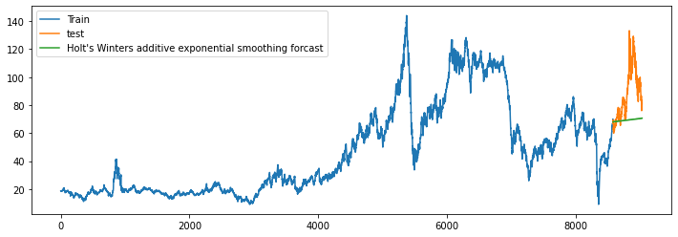
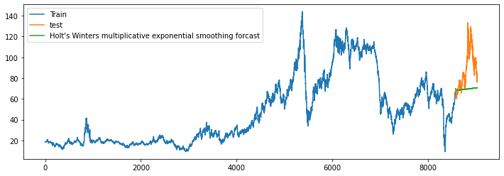
E. Holt's Winter additive method
F. Holt's Winter multiplicative method

Slide 25
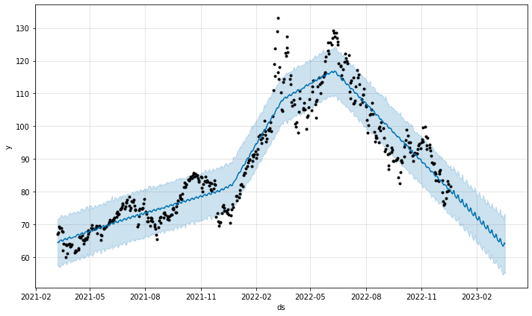
Model Selection
We selected Prophet Model by FB for deployment.
This graph is based on Test Data Set.

Slide 26
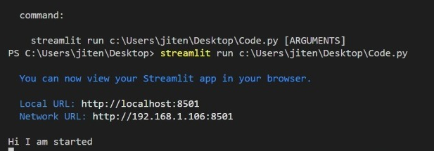
Deployment
We used Streamlit App for Deployment, and result is on next slide.

Slide 27
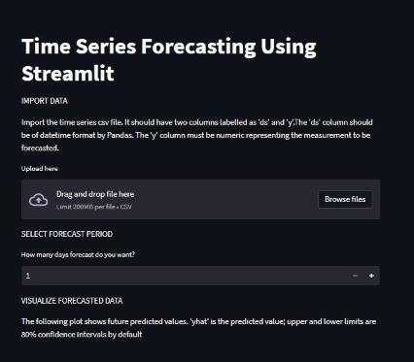
We can use this app for Forecasting of Oil Prices

Slide 28
Challenges
Limitation in extraction of our dataset :- The dataset doesn’t contain the external features affecting the crude oil prices like the supply and demand, inventory, speculation monetary market etc. as extracting these features require a good domain knowledge and as a result of which we were unable to find the right resources for same.
Model Building :- Forecasting models were performing a little poorly resulting unexpected outputs because of less features and also the long hyper parameter tuning time especially for LSTM & Prophet was a challenge.
Deployment :- Deployment model required a specific date-time format which added another step to pre-processing of the dataset.

Slide 29
THANK YOU!

